Slide 1
专业技能
专业技能
专业技能
Paper Presentation

Slide 2
OCT Super-resolution Reconstruction: Backgrounds & Challenges
Optical Coherence Tomography (OCT) is a non-invasive imaging technique widely used in medical diagnostics, especially ophthalmology.
Due to its high imaging resolution, it allows for detailed visualization of retinal structures, enabling early detection and precise diagnosis.
However, dense acquisition required for high resolution will decrease the imaging speed and thereby cause the discomfort of patients. Even worse, the longer acqusition time is likely to exacerbate eye motion, introducing artifacts into the image.
Solutions to the above issues
Various traditional methods are proposed to improve the digital resolution of under-sampled images, such as bicubic interpolation, sparse representation, and compressive sensing, which tend to perform poorly at low sampling rate.
With the rise of deep learning in recent years, neural networks can be leveraged to achieve superior performance compared to conventional methods.

Slide 3
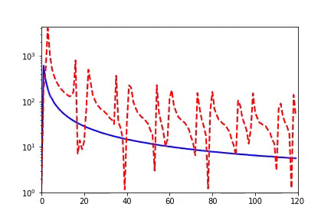
Inspiration1: F-pricinple
Diagram of F-pricinple^{[1]} (Deep Nerual Network (DNN) prefers low frequency)
[1] John Xu, et al. Frequency principle: Fourier analysis sheds light on deep neural networks.

Slide 4
Inspiration2: Unsharp masking
Scaling factor
Decompose
Residual Image
Input Image
Output (Sharpen) Image
Smoothing
Flow Diagram of Unsharp masking^{[1]} (USM).
[1] Deng Guang. A generalized unsharp masking algorithm.
Notes:
Note: Smoothing---Low frequency pass filter (e.g. Mean filter, Median filter, Bilateral filter, Box filter, Gaussian filter, Global Average Pooling)
Sharpening---High frequency pass filter (e.g. Prewitt filter, Roberts Cross filter, Sobel filter, Laplacian filter, LoG, Unsharp Masking, Max Pooling)

Slide 5
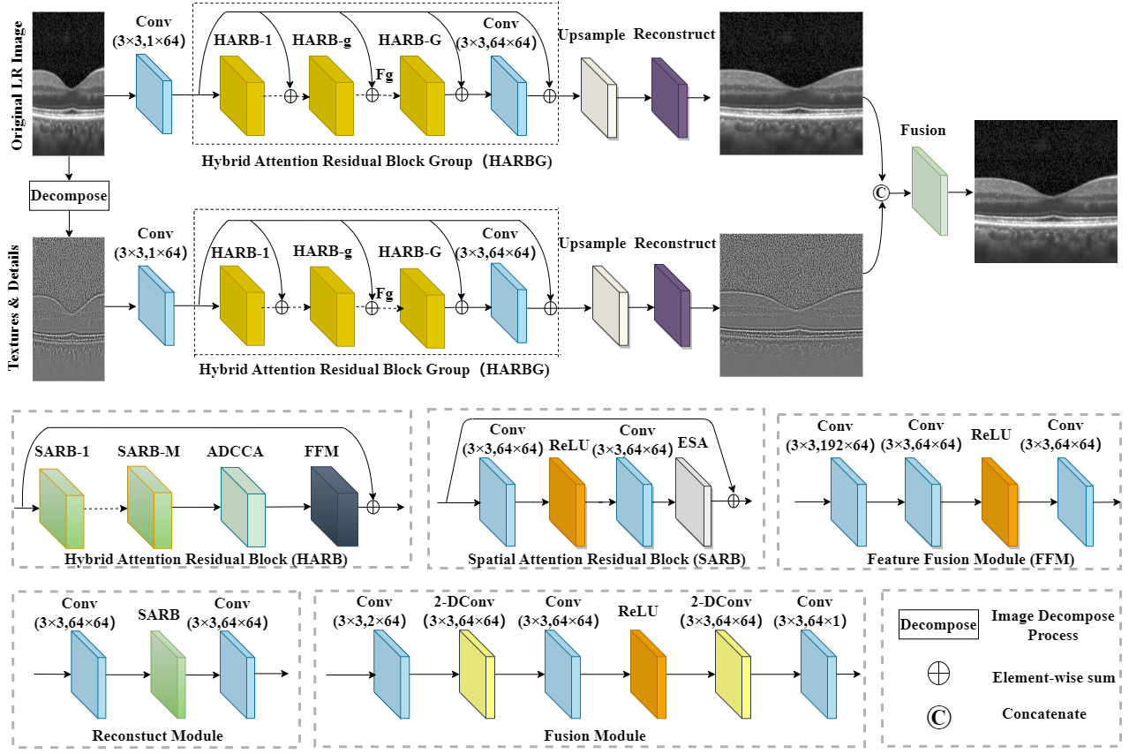
Framework of the proposed HASPN.
Hybrid attention structure preserving network for under-sampled OCT images reconstruction
SRᶜᵒᵃʳˢᵉ
SR
SRᵗᵉˣᵗᵘʳᵉ

Slide 6
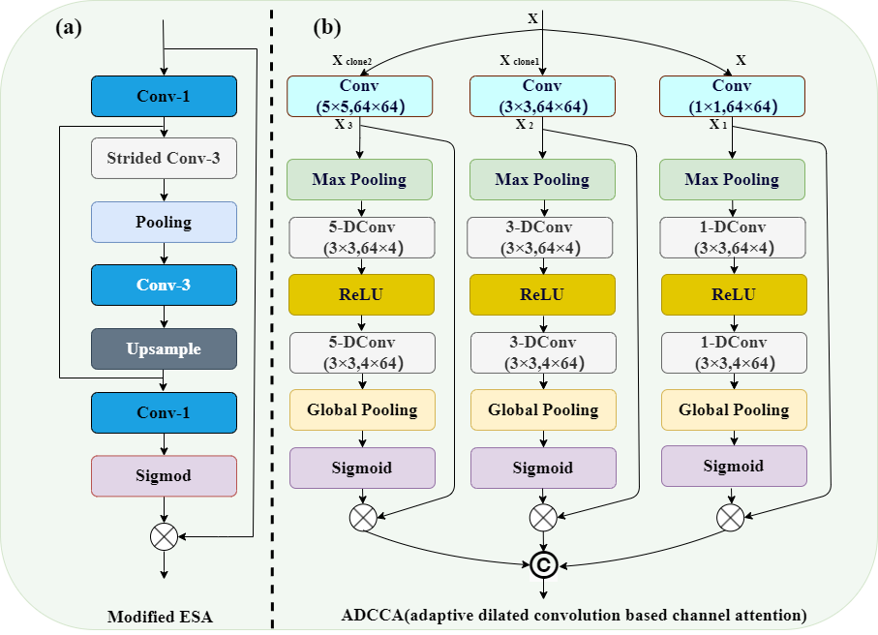
Hybrid attention mechanism in HASPN. (a) Modified ESA, where Conv-N represents a N×N convolutional layer. (b) ADCCA, where N-DConv (k×k, i×o) denotes a kxk convolutional layer with a dilation factor of N, input channel of i, and output channel of o.
Reduce the channel and spatial size
Squeeze
7x7 stride of 3 max pooling
Feature extraction
Excitation
Recover the spatial and channel size
The difference between ESA & Self-attention: 1.ESA: first-order Spatial Attention
2.Self-attention: second-order Spatial Attention

Slide 7
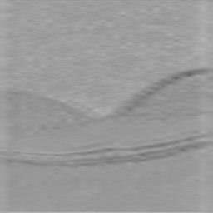
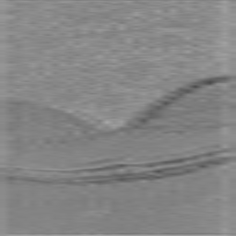
Visualization of feature maps. (a) The input feature map of ESA. (b) The output feature map of ESA.
(a)
(b)

Slide 8
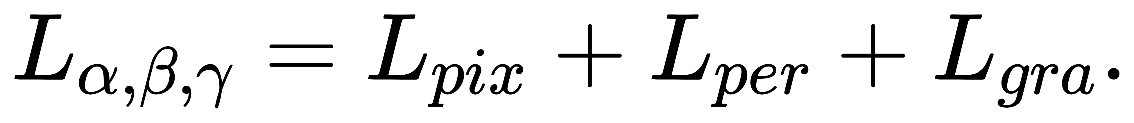
Deeply/Densely supervise the three output results of the dual branch
Lα: <SRᶜᵒᵃʳˢᵉ, GT>
Lβ: <SRᵗᵉˣᵗᵘʳᵉ, GTᵗᵉˣᵗᵘʳᵉ>
Lγ: <SR, GT>
Ensure the pixel reconstruction
Improve the vision performance
Avoid the smoothing effect
Sobel operator (one-order derivative)

Slide 9
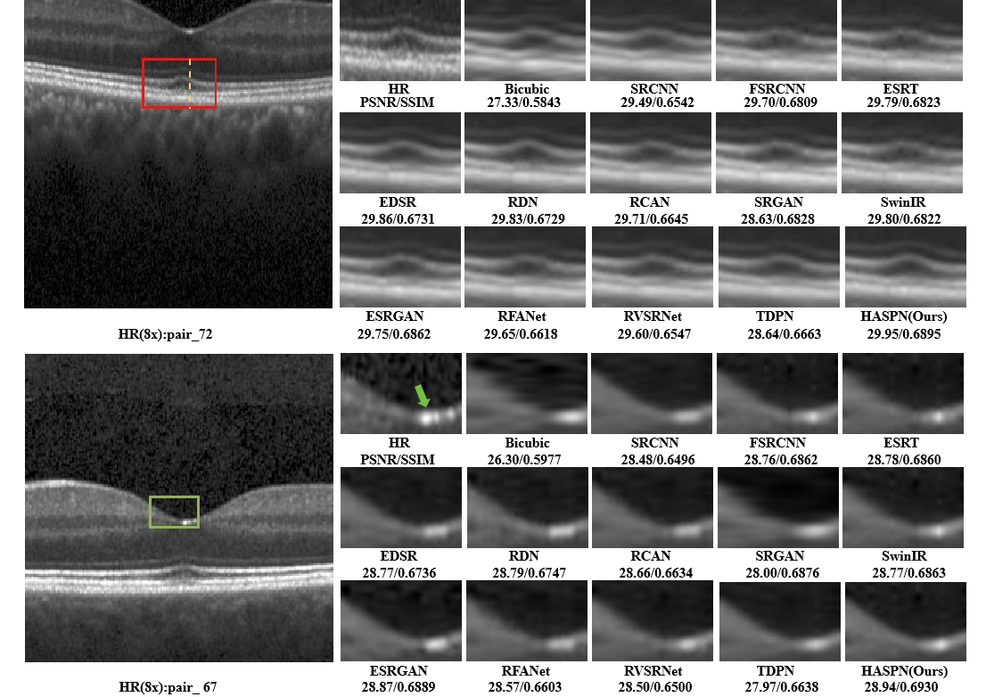
ELM
OS
RPE
Note: Green arrow: Central fovea Green circle: INL

Slide 10
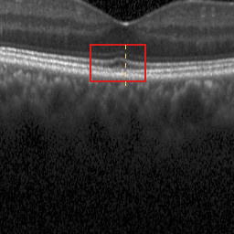
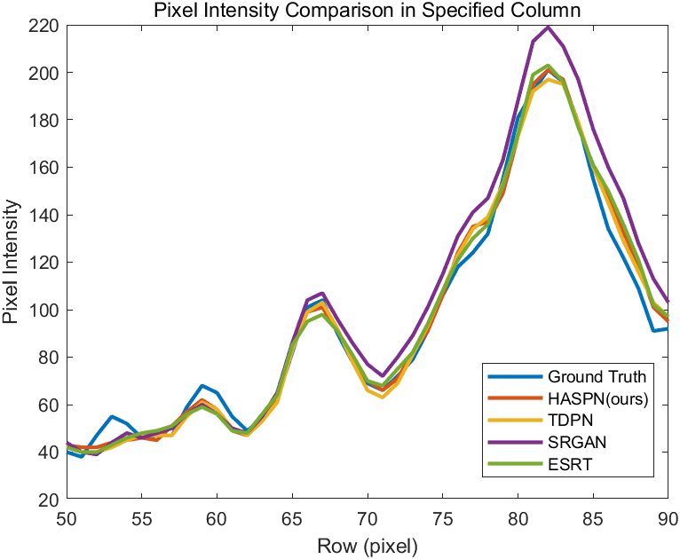
Profile of the orange dashed line in the left image.

Slide 11
Table 1 Quantitative comparisons of 2x, 4x, and 8x SR. The upward arrow (↑) indicates that higher values yield better performance. The best and second best results were highlighted and underlined, respectively.
Methods | 2x |  | 4x |  | 8x
 | PSNR↑ | SSIM↑ | PSNR↑ | SSIM↑ | PSNR↑ | SSIM↑
Bicubic | 31.73 | 0.8410 | 27.68 | 0.6633 | 25.74 | 0.5686
SRCNN | 33.62 | 0.8877 | 29.44 | 0.7102 | 27.79 | 0.6276
FSRCNN | 33.66 | 0.8884 | 30.11 | 0.7637 | 28.25 | 0.6733
EDSR | 33.59 | 0.8871 | 29.95 | 0.7593 | 28.29 | 0.6538
RDN | 33.67 | 0.8897 | 29.92 | 0.7589 | 28.27 | 0.6541
RCAN | 32.55 | 0.8667 | 30.01 | 0.7507 | 28.14 | 0.6421`
SRGAN | 32.42 | 0.8620 | 29.68 | 0.7402 | 28.35 | 0.6624
ESRGAN | 33.73 | 0.8913 | 29.74 | 0.7557 | 28.34 | 0.6645
RFANet | 33.69 | 0.8898 | 29.97 | 0.7604 | 28.04 | 0.6392
TDPN | 31.36 | 0.8761 | 30.06 | 0.7629 | 27.64 | 0.6482
SwinIR | 33.54 | 0.8861 | 29.96 | 0.7607 | 28.30 | 0.6739
ESRT | 33.49 | 0.8862 | 29.95 | 0.7611 | 28.28 | 0.6742
HASPN(ours) | 32.65 | 0.8881 | 30.14 | 0.7650 | 28.55 | 0.6786

Slide 12
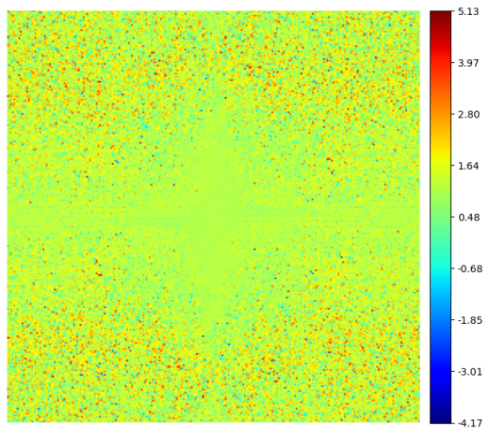
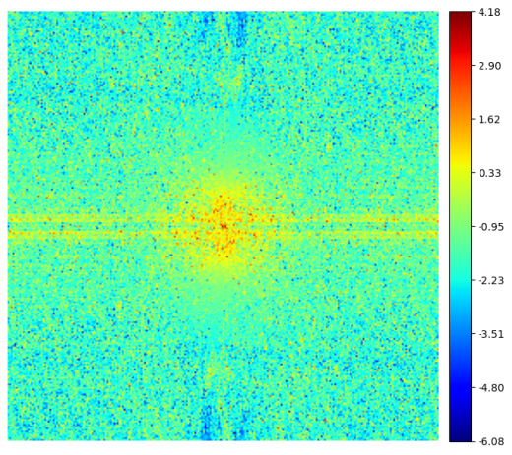
Spectral amplitude difference maps. (a) Difference map of the original branch reconstructed image and the final SR image. (b) Difference map of the textures & details branch reconstructed image and the final SR image.
(a) (b)

Slide 13
Table 2 Quantitative comparison of HASPN architectures with different widths and depths at 4x SR. G, M, C represent the number of HARB, SARB, and channel in each layer, respectively. The best and the worst results were highlighted and underlined, respectively.
G | M | C | PSNR↑ | SSIM↑
20 | 5 | 64 | 30.14 | 0.7650
16 | 5 | 64 | 29.57 | 0.7564
8 | 5 | 64 | 28.66 | 0.7474
20 | 4 | 64 | 29.83 | 0.7546
20 | 2 | 64 | 29.17 | 0.7536
20 | 5 | 32 | 29.12 | 0.7352
20 | 5 | 16 | 29.08 | 0.7287

Slide 14
Table 3 Comparison of ablating different key components on 8x SR.
Model | ESA | ADCCA | Tex Branch | PSNR↑ | SSIM↑
Model1 | × | × | × | 28.01 | 0.6359
Model2 | √ | × | × | 28.11 | 0.6404
Model3 | × | √ | × | 28.23 | 0.6492
Model4 | √ | √ | × | 28.26 | 0.6540
Model5 | √ | √ | √ | 28.55 | 0.6786
Table 4 Comparison of ablating different losses on 8x SR.
Loss | Pix | Per | Gra | PSNR↑ | SSIM↑
Loss1 | √ | × | × | 28.18 | 0.6645
Loss2 | × | √ | × | 25.68 | 0.4913
Loss3 | × | × | √ | 28.17 | 0.6756
Loss4 | √ | √ | √ | 28.55 | 0.6786

Slide 15
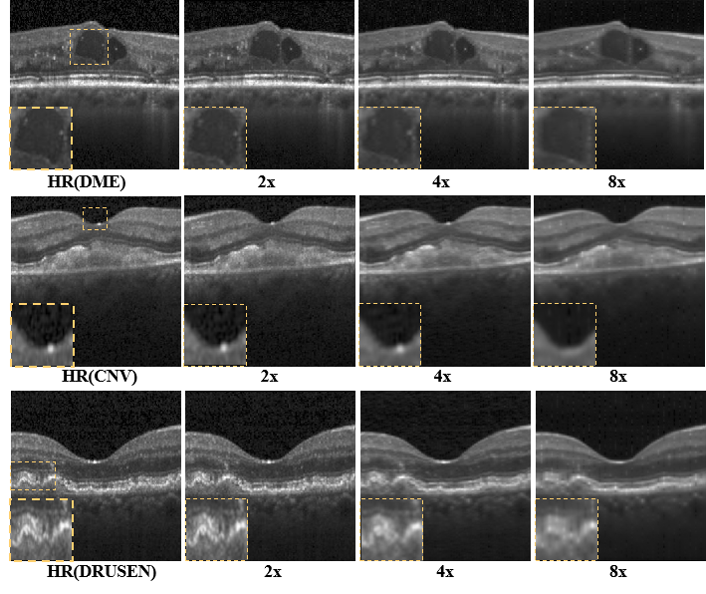
Generalization performance of the proposed network on three abnormal OCT dataset.

Slide 16
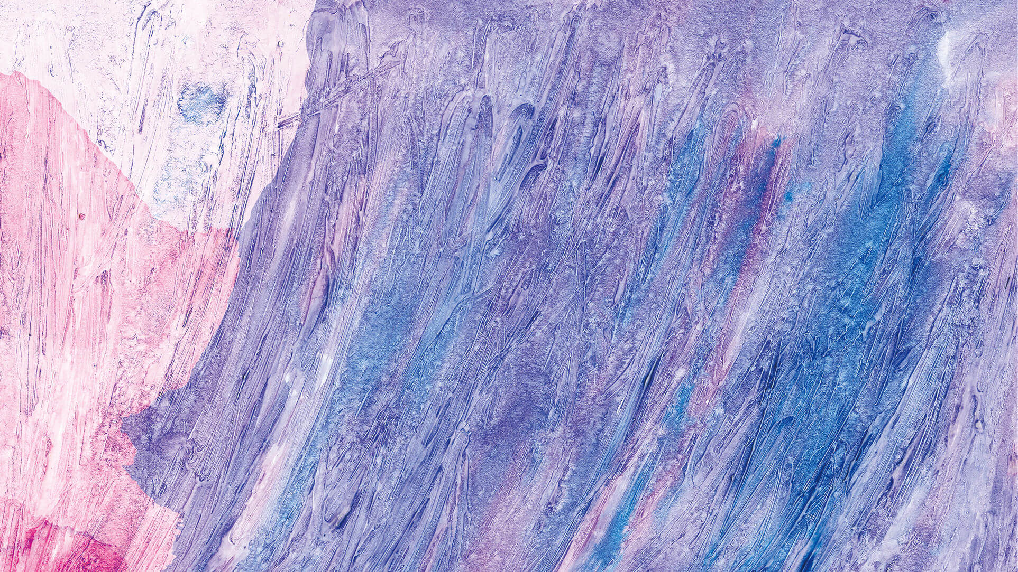
· · · · · PAPER PRESENTATION
Thank you for
watching
Author: Zezhao Guo (郭泽钊)

